Slide 1
Prolactin
Prolactin (PRL) is a single chain 198 amino acid polypeptide secreted by the anterior pituitary .
Structurally similar to GH, its receptors resemble GH receptors,
Prolactin also binds to specific receptors in the gonads, lymphoid cells, and liver
Pulsatile, circadian fashion
Highest – sleep
Nadir (lowest) – 10 am to noon
Reference Range Serum PRL
1-25 ng/mL or ug/L for females
1-20 ng/mL or ug/L for males

Slide 2
Factors affecting PRL secretion
Factors increasing PRL secretion
Estrogen (during pregnancy stimulates lactotropes to secrete PRL)
Breast feeding (reflex increase)
TRH
Stress
sleep
Dopamine antagonists
chest wall stimulation or trauma
Factors inhibiting PRL secretion
Dopamine
Bromocryptine, metoclopramid (Dopamine agonist)
Somatostatin
PRL (by negative feedback)

Slide 3
Prolactin action
PRL is responsible for Lactogenesis (initiation of lactation) & galactopoiesis (continuation of lactation)
- Stimulates milk production in the breasts by formation of Casein & Lactalbumin
Stimulates breast development along with Estrogen during pregnancy
Inhibits Ovulation by decreasing secretion of LH & FSH
May be involved in development of Leydig cells in pre-pubertal males
Immunomodulatory effects– stimulates T cell functions
Prolactin receptors in thymus

Slide 4
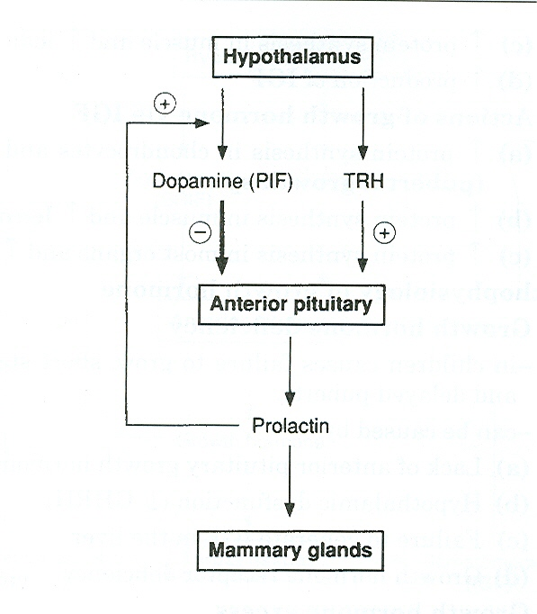
Regulation of Prolactin secretion
Secretion of prolactin is under tonic inhibitory control by dopamine, which acts via D2-type receptors located on lactotrophs
Prolactin production can be stimulated by the hypothalamic peptides, thyrotropin-releasing hormone (TRH) and vasoactive intestinal peptide (VIP)
positive feedback by sucking infant

Slide 5
Causes of Hyperprolactinemia
Hypothalamic Dopamine Deficiency
Diseases of the hypothalamus( including tumors, arterio-venous malformations, and inflammatory processes )
Drugs (e.g. alpha-methyldopa and reserpine)
Defective Transport Mechanisms
Section of the pituitary stalk
Pituitary or stalk tumors
Lactotroph Insensitivity to Dopamine
Dopamine-receptor-blocking agents: phenothiazines (e.g. chlorpromazine), butyrophenones (haloperidol), and benzamides (metoclopramide, sulpiride, and domperidone)
Stimulation of Lactotrophs
Hypothyroidism- increased TRH production (acts as a PRF)
Estrogens: stimulate lactotrophs
Injury to the chest wall: abnormal stimulation of the reflex associated with the rise in prolactin that is seen normally in lactating women during suckling
Ectopic secretion of prolactin by nonpituitary tumors

Slide 6
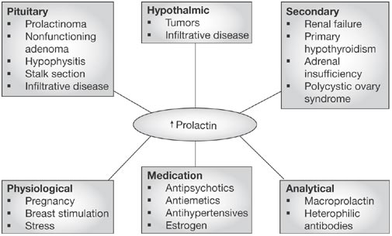

Slide 7
Clinical Features of Hyperprolactinemia/Prolactinoma
rule out secondary causes
Women
Oligomenorrhea
Amenorrhea (because GnRH release is decreased in direct response to PRL, inhibits release of FSH & LH )
galactorrhea
infertility
Hirsutism
Men often have less symptoms than women , Tend to present later
- Gynaecomastia
Impotence-- often ignored
Most common functional pituitary tumor usually a microadenoma
space occupying macroadenoma
In both sexes, tumor mass effects may cause visual-field defects or headache
Treatment: Dopamine agonists like Bromocryptine which decreases PRL secretion

Slide 8
Prolactinoma
Diagnosis
Assess hypersecretion
Basal, fasting morning PRL levels (normally <20 ug/L)
Multiple measurements may be necessary
Pulsatile hormone secretion
levels vary widely in some individuals with hyperprolactinemia
Both false-positive and false-negative results may be encountered
May be falsely lowered with markedly elevated PRL levels (>1000 ug/L)
assay artifacts; sample dilution is required to measure these high values accurately
May be falsely elevated by aggregated forms of circulating PRL, which are biologically inactive (macroprolactinemia)
Hypothyroidism should be excluded by measuring TSH and T4 levels
Exclude Drugs which decrease dopamine stores
If prolactin level > 200, almost always a prolactinoma (even in a nursing mothers)
Prolactin levels correlate with tumor size in the macroadenomas
Suspect another tumor if prolactin low with a large tumor

Slide 9
ACTH
also known as corticotropin
ACTH is made up of 39 amino acids
is a polypeptide tropic hormone produced in the anterior pituitary by proteolytic processing of Prepro-opiomelanocortin (POMC).
Other neuropeptide products include β and γ lipotropin, β-endorphin, and α-melanocyte-stimulating hormone (α-MSH) the role of it in anterior pituitary is not completely understood
ACTH principal effects are increased production and release of corticosteroids.
Overproduction of ACTH may accompany increased pigmentation due to α-MSH

Slide 10
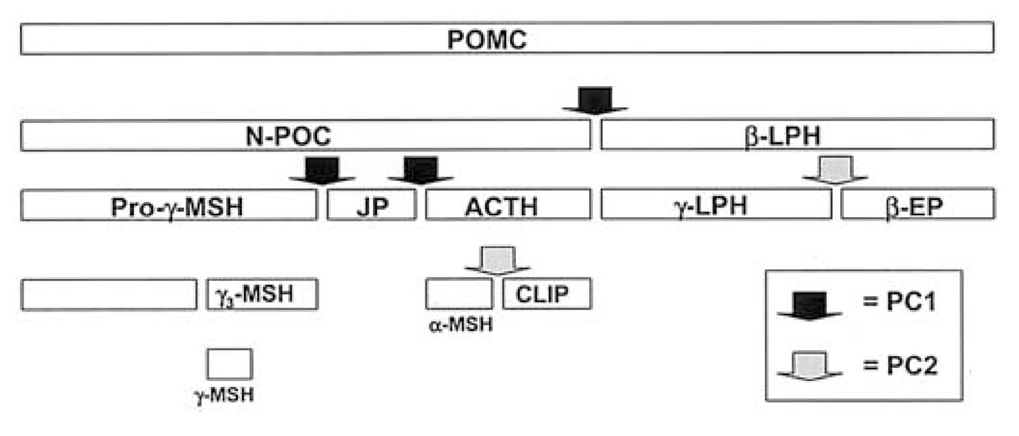
ACTH synthesis
ACTH
Processing and cleavage of pro-opiomelanocortin (POMC)

Slide 11
- Vasopressin potentiates CRH at both hypothalamic and pituitary levels.
Circadian pattern of release
Highest levels of cortisol are in early AM following ACTH release
pituitary tumor is the cause of elevated ACTH this is known as Cushing's Disease .
Cushing’s syndrome is a rare condition that is the result of too much of the hormone cortisol in the body regardless of the cause.Such patients present with signs and symptoms of the excess cortisol (hypercortisolism) .It is caused by:
ACTH producing pitu tumors
cortisol-like medications (called glucocorticoids)
ACTH producing ectopic tumors
Cortisol producing adrenal glands
Primary adrenal insufficiency, also called Addison's disease, occurs when adrenal gland production of cortisol is chronically deficient, resulting in chronically elevated ACTH levels, Skin color will darken

Slide 12
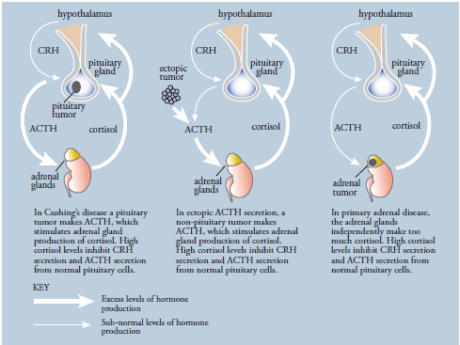
Figure The various causes of Cushing’s syndrome

Slide 13
Disorders of ACTH secretion
Increase secretion
- CRH
Adrenalectomy
Stress:
Hypoglycemia
Surgery & trauma
anesthesia
Infection & pyrogens
ADH
Psychiatric disturbances:
Anxiety, depression
adrenergic antagonists
Serotonin
Acetylcholine
Interleukines
Gastrointestinal peptides
Decrease secretion
Increase cortisol
ACTH
Somatostatin
Opiod
Enkephalins
GABA

Slide 14
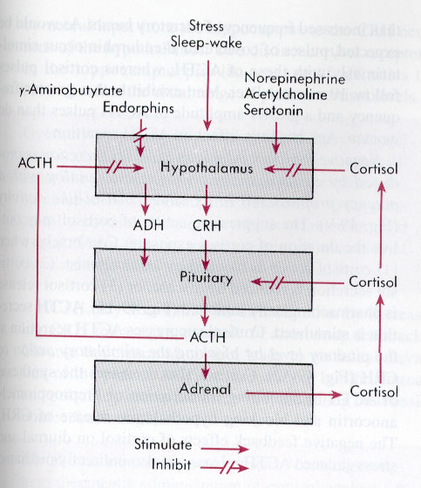
Regulation of ACTH

Slide 15
• ACTH deficiency → (within 2 weeks) symptoms of cortisol
insufficiency are developed
- nausea, vomiting, anorexia, fatigue, weakness
hypoglycemia :caused by
increased sensitivity of tissues to insulin
decreased glycogen reserves
decreased gluconeogenesis)
in women, loss of body hair and decreased libido →
→ due to decreased adrenal androgen production
- No features of mineralocorticoid deficiency
Aldosterone secretion is unaffected

Slide 16
excessive secretion of corticotrophin (ACTH) → central form of Cushing syndrome (Cushing disease)
Causes:
- micro- or macroadenomas of adenohypophysis
- hypothalamic disorders
Pathophysiology:
Chronic hypercortisolism is the main disturbance of ↑ ACTH
Symptoms and signs:
weight gain: - accumulation of adipose tissue in the trunk, facial, and
cervical areas (truncal obesity, moon face, buffalo hump)
- weight gain from Na and water retention
• glucose intolerance → DM type 2
• polyuria: osmotic polyuria due to glycosuria

Slide 17
The ACTH stimulation
test (also called Synacthen test) is a medical test to assess the functioning of the adrenal glands stress response by measuring the adrenal response to adrenocorticotropic hormone (ACTH) .
ACTH is a hormone produced in the anterior pituitary gland that stimulates the adrenal glands to release cortisol and Dehydroepiandrosterone (DHEAS).
During the test, a small amount of synthetic ACTH is injected, and the amount of cortisol, and sometimes aldosterone, the adrenals produce in response is measured. This test may cause mild to moderate side effects in some individuals.
This test is used to diagnose or exclude primary and secondary adrenal insufficiency, Addison's disease and related conditions. In addition to quantifying adrenal insufficiency, the test can distinguish whether the cause is adrenal (low cortisol and aldosterone production) or pituitary (low ACTH production)

Slide 18
Melanocyte-stimulating hormone (MSH)
MSH peptides derived by proteolytic cleavage of POMC
α-MSH has antipyretic and anti-inflammatory effects
Also inhibits CRH and LHRH secretion
Four MSH receptors identified
May inhibit feeding behavior
ACTH has MSH-like activity
However– MSH has NO ACTH like activity

Slide 19
LH, FSH
Secreted from cells in anterior pituitary .
Synthesis and secretion stimulated by GnRH– major effect on LH
LH, FSH α and β subunits, Each subunit encoded by different gene
α subunit is identical for all 4 hormones(TSH and hCG)
β subunit are unique and provide biological specificity.
Pulsatile pattern of secretion
LH pulses are biphasic (every 1 minute, then large pulse at 1 hour)
FSH pulses are uniphasic
Diurnal– LH/FSH more pronounced during puberty
Cyclic in females– ovarian cycle with LH surge at time of ovulation
Males are not cyclic, but constant pulses of LH cause pulses of testosterone to be produced

Slide 20
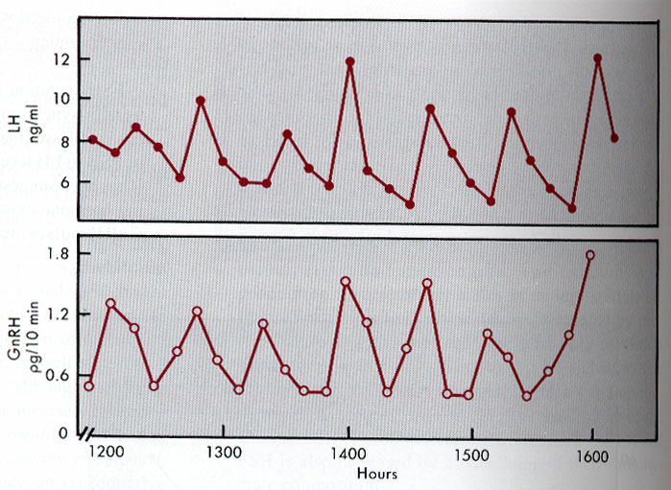
Pulsatile secretion of GnRH and LH
FSH secretion controlled by inhibin
Pulsatile secretion of GnRH and inhibin cause distinct patterns of LH and FSH secretion

Slide 21
Inhibin was initially isolated from gonadal fluids based on its ability to selectively inhibit FSH secretion from pituitary cells.
Inhibin is a heterodimer composed of an α -subunit and a β A- or β B-subunit to form inhibin A or inhibin B, both of which are secreted from the ovary.
Activin is a homodimer of inhibin β subunits with the capacity to stimulate the synthesis and secretion of FSH.
-Inhibin B also plays an important negative feedback role on FSH, independent of estradiol, during the menstrual cycle.
- it unlikely that ovarian activin plays an endocrine role in FSH regulation. However, activin may play an autocrine /paracrine role in the ovary, and it may also act locally in the pituitary to modulate FSH production.

Slide 22
HORMONAL INTEGRATION OF THE NORMAL MENSTRUAL CYCLE
The sequence of changes in reproductive function is coordinated through a series of feedback loops that alter pulsatile GnRH secretion, the pituitary response to GnRH, and the relative secretion of LH and FSH from the gonadotrope.
Negative feed-back
Activin is produced in both pituitary gonadotropes and folliculostellate cells and stimulates the synthesis and secretion of FSH.
Inhibins function as potent antagonists of activins through sequestration of the activin receptors. Although inhibin is expressed in the pituitary, gonadal inhibin is the principal source of feedback inhibition of FSH.
For the majority of the cycle, the reproductive system functions in a classic endocrine negative feedback mode. Estradiol and progesterone inhibit GnRH secretion, and the inhibins act at the pituitary to selectively inhibit FSH synthesis and secretion .
This negative feedback control of FSH is critical to development of the single mature oocyte in women.
Testosterone from Leydig cells– synthesis stimulated by LH, feedsback to inhibit GnRH production from hypothalamus and down-regulates GnRH receptors
Positive feedback
The exponential rise in estradiol results in positive feedback on the pituitary, leading to the generation of an LH surge (and a smaller FSH surge), that is essential for ovulation of a mature follicle.

Slide 23
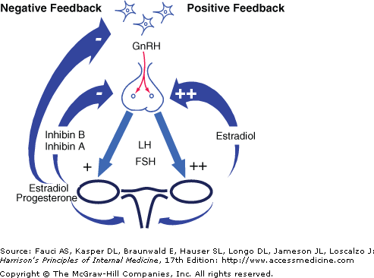

Slide 24
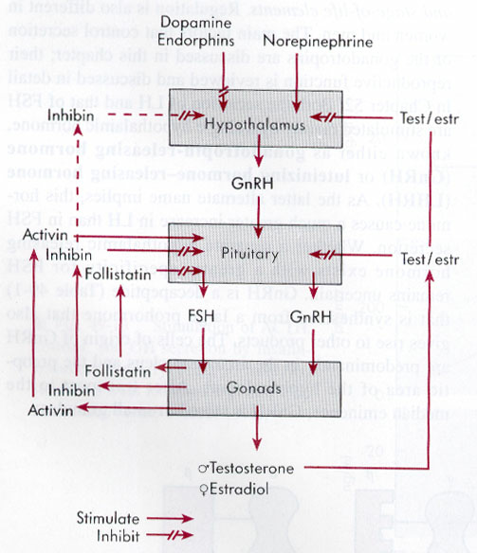
Regulation of gonadotropin secretion

Slide 25
Disorders of Puberty
PRECOCIOUS PUBERTY
- Traditionally has been defined as the development of secondary sexual characteristics before the age of 8 in girls - More recently, if breast development or pubic hair were present at <7 years of age for Caucasian girls or <6 years for African-American girls.
It is characterized by pulsatile LH secretion and an enhanced LH and FSH response to exogenous GnRH (two- to threefold stimulation) .
True precocity is marked by advancement in bone age of >2 SD .
In girls, centrally mediated precocious puberty is idiopathic in ~85% of cases; however, neurogenic causes must also be considered.

Slide 26
Differential Diagnosis of Precocious Puberty
Central (GnRH dependent) | Peripheral (GnRH independent)
Idiopathic | Congenital adrenal hyperplasia
CNS tumors | Estrogen-producing tumors
Hamartomas | Adrenal tumors
Astrocytomas | Ovarian tumors
Adenomyomas | Gonadotropin/hCG-producing tumors
Gliomas | Exogenous exposure to estrogen or androgen
Germinomas | McCune-Albright syndrome
CNS infection | Aromatase excess syndrome
Head trauma
Iatrogenic
Radiation
Chemotherapy
Surgical
CNS malformation
Arachnoid or suprasellar cysts
Septo-optic dysplasia
Hydrocephalus

Slide 27
DELAYED PUBERTY
Is the absence of secondary sexual characteristics by age 13 in girls. The diagnostic considerations are very similar to those for primary amenorrhea
- Between 25 and 40% of delayed puberty in girls is of ovarian origin, with Turner syndrome constituting a majority of such patients.
Functional hypogonadotropic hypogonadism encompasses diverse etiologies such as systemic illnesses, including celiac disease and chronic renal disease, and endocrinopathies, such as diabetes and hypothyroidism.
abnormalities in energy balance that result from exercise, dieting, and/or eating disorders. Together these reversible conditions account for ~25% of delayed puberty in girls.
Congenital hypogonadotropic hypogonadism in girls or boys can be caused by mutations in several different genes or combinations of genes .Family studies suggest that genes identified in association with absent puberty may cause delayed puberty and that there may be a genetic susceptibility to environmental stresses such as diet and exercise.
neuroanatomic causes of delayed puberty are considerably less common in girls than in boys, it is always important to rule these out in the setting of hypogonadotropic hypogonadism.

Slide 28
Differential Diagnosis of Delayed Puberty
Hypergonadotropic | Hypogonadotropic
Ovarian | Genetic
Turner syndrome | Hypothalamic syndromes
Gonadal dysgenesis | Letpin/leptin receptor
Chemotherapy/radiation therapy | HESX1 (septooptic dysplasia)
Galactosemia | PC1 (prohormone convertase)
Autoimmune oophoritis | IHH and Kallmann syndrome
Congenital lipoid hyperplasia | KAL, FGFR1
Steroidogenic enzyme abnormalities | GnRHR, GPR54
17-hydroxylase deficiency | Abnormalities of pituitary development/function
Aromatase deficiency | PROP1
Gonadotropin/receptor mutations | CNS tumors/infiltrative disorders
FSH, LHR, FSHR | Craniopharyngioma
Androgen resistance syndrome | Astrocytoma, germinoma, glioma
 | Prolactinomas, other pituitary tumors
 | Histiocytosis X
 | Chemotherapy/radiation
 | Functional
 | Chronic diseases
 | Malnutrition
 | Excessive exercise, Eating disorders

Slide 29
Evaluation of Precocious and Delayed Puberty
Initial screening tests | Precocious | Delayed
History and physical | x | x
Assessment of growth velocity | x | x
Bone age | x | x
LH, FSH | x | x
Estradiol, testosterone | x | x
DHEAS | x | x
17-Hydroxyprogesterone | x
TSH, T₄ | x | x
Complete blood count |  | x
Sedimentation rate, C-reactive protein |  | x
Electrolytes, renal function |  | x
Liver enzymes |  | x
IGF-I, IGFBP-3 |  | x
Urinalysis |  | x

Slide 30
Evaluation of Precocious and Delayed Puberty…cont.
Secondary tests | Precocious | Delayed
Pelvic ultrasound | x | x
Cranial MRI | x | x
-hCG | x
GnRH/agonist stimulation test | x | x
ACTH stimulation test | x
Inflammatory bowel disease panel | x | x
Celiac disease panel |  | x
Prolactin |  | x
Karyotype |  | x

Slide 31
Thyroid stimulating hormone(TSH)
Is also known as thyrotropin, is secreted from cells in the anterior pituitary cells(thyrotrophs) when stimulated by TRH
Its basic sequence is glutamic acid-histidine-proline
It acts on its receptors on epithelial cells in the thyroid gland, and stimulates it to synthesize and release thyroid hormones T₃ and T₄.
Pattern of secretion is relatively steady
TSH is a glycoprotein hormone composed of two subunits which are non-covalently bound to one another.
The alpha subunit of TSH is also present in two other pituitary FSH and LH, in the placental hormone hCG.
The α subunit is thought to be the effector region responsible for stimulation of adenylate cyclase (involved the generation of cAMP)
Each of these hormones also has a unique beta subunit, which provides receptor specificity.

Slide 32
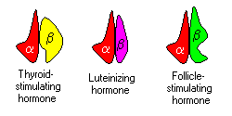
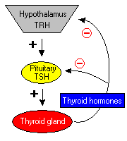
Feedback control of thyroid function
Secretion of TRH, and hence, TSH, is inhibited by high blood levels of thyroid hormones in a classical negative feedback

Slide 33
TSH Excess
Benign tumor of the pituitary (adenoma)
Congenital hypothyroidism (cretinism)
Primary hypothyroidism i.e. Hashimoto's thyroiditis
pregnancy,& trophoblastic tumors : hCG shows some cross-reactivity to the TSH receptor and therefore can stimulate production of thyroid hormones
Laboratory findings
Source of pathology | TSH level | TH level | Disease causing conditions
Hypothalamus/pituitary | High | High | Benign tumor of the pituitary (adenoma) or thyroid hormone resistance
Hypothalamus/pituitary | Low | Low | Secondary hypothyroidism or "central" hypothyroidism
Thyroid | Low | High | Primary hyperthyroidism i.e. Graves' disease
Thyroid | High | Low | Congenital hypothyroidism (cretinism), Primary hypothyroidism i.e. Hashimoto's thyroiditis

Slide 34
TSH Deficiency
Grave`s disease:
Hyperthyroidism caused by circulating antibodies to the TSH receptor.
Associated with diffuse goiter.
Autoantibodies bind to TSH receptor and mimic the action of TSH itself leads to persistent stimulation of thyroid and elevated levels of thyroid hormones
Somatostatin is also produced by from the hypothalamus, inhibits the pituitary production of TSH
Primary hyperthyroidism i.e. Graves' disease
Secondary hypothyroidism or "central" hypothyroidism
TSH concentrations are measured as part of a thyroid function test
TSH is secreted throughout life but particularly reaches high levels during the periods of rapid growth and development
reference range for adults to be reduced to 0.4–2.5 µIU/mL
0.4–7.0 µIU/mL at 14 months age

